Slide 1
Working with .NET Interactive Notebooks
Presenter: Maximo Trinidad
Technology Evangelist
SAPIEN Technologies, Inc.

Slide 2
Coders Cafe User Group Thank You for having me!

Slide 3
Warning … My House Alarm may go off!!

Slide 4

I mean … My Guard Dogs!!

Slide 5


Agenda
About Me
SAPIEN Technologies Products
What Is Required?
Notebook Apps
Demo

Slide 6


About Me
Florida IT Community Speaker since 2006 attending:
.NET Code Camps
SQLSaturday
IT Pro Camps
Microsoft MVP since 2009 – PowerShell/Cloud and Datacenter Management.
Technology Evangelist for SAPIEN Technologies, Inc. since 2017.
Contact Information:
Email: maxt@sapien.com
Twitter: @maxtrinidad
LinkedIn: https://www.linkedin.com/in/maximo-trinidad-77504712/

Slide 7
SAPIEN Technologies Products

Slide 8









SAPIEN DevOps Suite
PowerShell Studio
PrimalScript
PowerShell HelpWriter
PowerShell ModuleManager
CIM Explorer
VersionRecall
PrimalSQL
PrimalXML

Slide 9
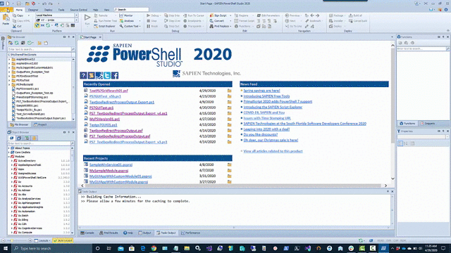
PowerShell Studio
Creating Scripts and PowerShell Tools
Create PowerShell GUIs.
Convert scripts into executable (.exe) files.
Create MSI installers.
Create modules from your existing functions or help files.
Create advanced functions using the Function Builder.
Create windows services using PowerShell.
Monitor script performance and memory usage.
Source Control and Git integration.
Integrated PowerShell consoles (32-bit & 64-bit).
Remote debugging.
Built-in PowerShell help.
Supports Windows PowerShell 3.0, 5.1 and PowerShell 7.
Code Formatting.

Slide 10
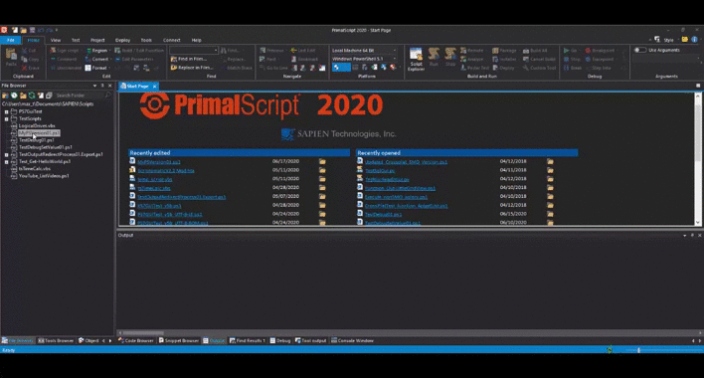
PrimalScript
Supports over 50 languages and file types.
Supports 32-bit and 64-bit platform development.
Next generation PowerShell local and remote debugger.
Supports PowerShell V3, V4 and V5 at the same time.
Script against a remote machine’s Installed Module Set (IMS).
Remote VBScript, JScript and PowerShell debugger.
Supports PowerShell variable and function breakpoints.
Integrated 32-bit and 64-bit PowerShell and command console.
PowerShell dialog editor.
Multi-file and module debugging.
Single click build for packages, MSI databases and deployment.
Plus much more.

Slide 11
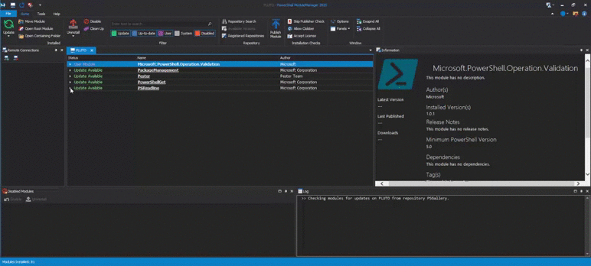
PowerShell ModuleManager
Search the PowerShell Gallery or any other repository for new modules.
Remove duplicate and outdated versions of modules to prevent version confusion.
Install, remove or temporarily disable modules.
Keep modules up-to-date.
Filter and find specific modules on your machine.
View detailed module information at a glance.
Move and organize module locations.
Manage modules on remote machines.
Publish modules to a repository.

Slide 12
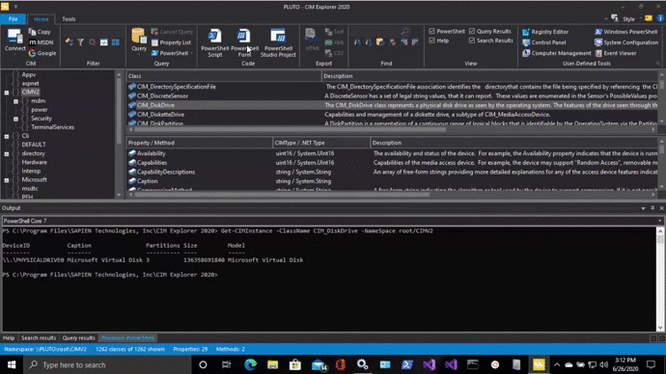
CIM Explorer
Preset and custom queries let you not only examine the classes, properties and methods but also the underlying data.
Generates sample code for PowerShell (GUI & non-GUI), and VBScript, including calls to CIM methods.
A large variety of search options to access the information faster and more precisely.
Superior performance using cached data and multi-threaded code gets you results fast.
Local cache allows you to browse remote machines even when not connected.
Filters allow you to reduce noise and focus only on relevant information.
Explore and query local and remote machines.
View all documentation for any WMI object.

Slide 13
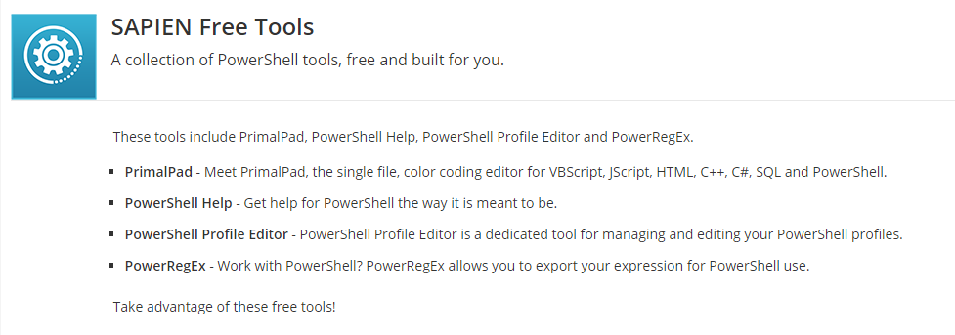

Slide 14
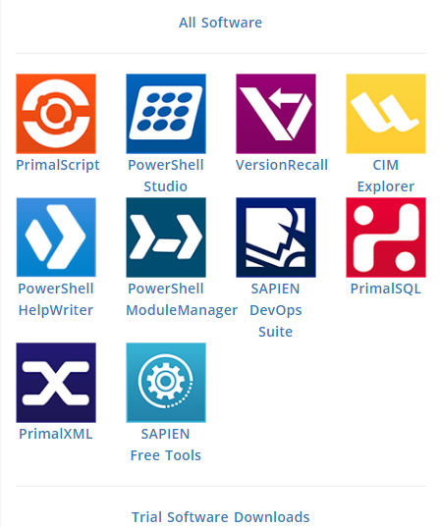
For Information
email: sales@sapien.com
Visit our website: www.sapien.com
Feature Requests: https://www.sapien.com/requests
Support Forums: https://www.sapien.com/forums

Slide 15
What Is Required?

Slide 16

What Is Required?
Windows 10 Client
WSL 2 - Ubuntu 18.04/20.04
Anaconda - Data Science Platform
SQL Server 2019
.NET Interactive and Global Tools
Additional Python Packages
Windows Terminal
Coding Editors

Slide 17
What Is Required?
Windows 10 Client
RTM Version 2004 (updated July 2020)
Or, Windows Insider Release

Slide 18
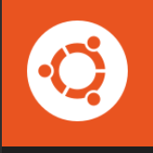

What Is Required?
WSL 2 - Ubuntu 18.04/20.04
Lightweight VM (not supported by Hyper-V)
Own IP-Address
Caution: Any added Distro will share this IP-Address
Environment perfect for Docker Containers
Use XRPD got get the Graphical Desktop
WSL2 will have graphical desktop available later.

Slide 19

What Is Required?
Anaconda - Data Science Platform
Includes Jupyter Notebooks (v1 – v2)
Only Python Kernel is included.
PowerShell is supported for console shell.
Latest version includes Python 3.8
Note: This demo needs use Jupyter Notebook v1.x to support SQLAchemy Python SQL Tool.

Slide 20

What Is Required?
SQL Server 2019
Windows and Linux are supported.
WSL 2 not supported.
Can’t run as a service but can run in an active session.

Slide 21
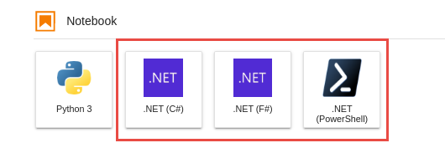
What Is Required?
.NET Interactive and Global Tools
Includes the following Jupyter Kernels:
C#
F#
PowerShell
Note: Other Kernels are available such as: Spark and NodeJS.

Slide 22
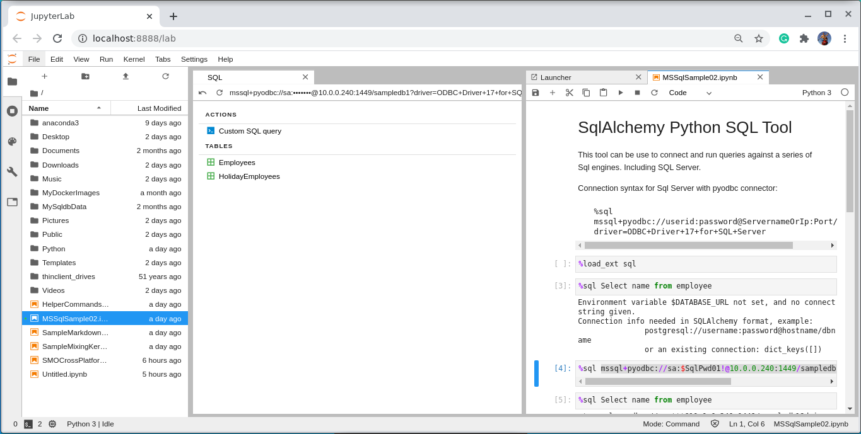
What Is Required?
Additional Python Packages
iPython – Interactive Shell for Jupyter.
PyODBC - Databases connector for both Windows and Linux.
SQLAlchemy - Python SQL Tool support: Postgres, SQLLite, MySQL, and SQLServer.

Slide 23
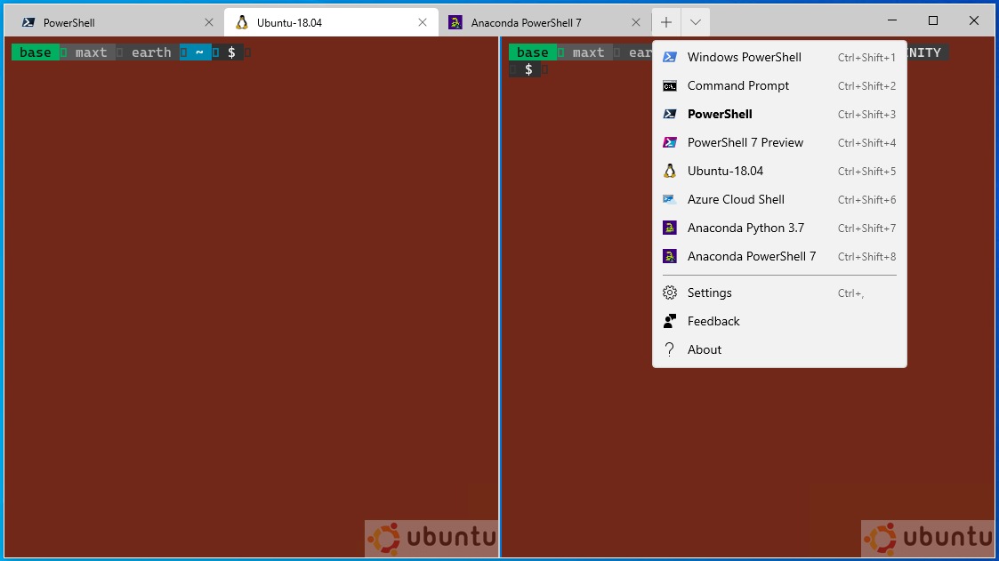
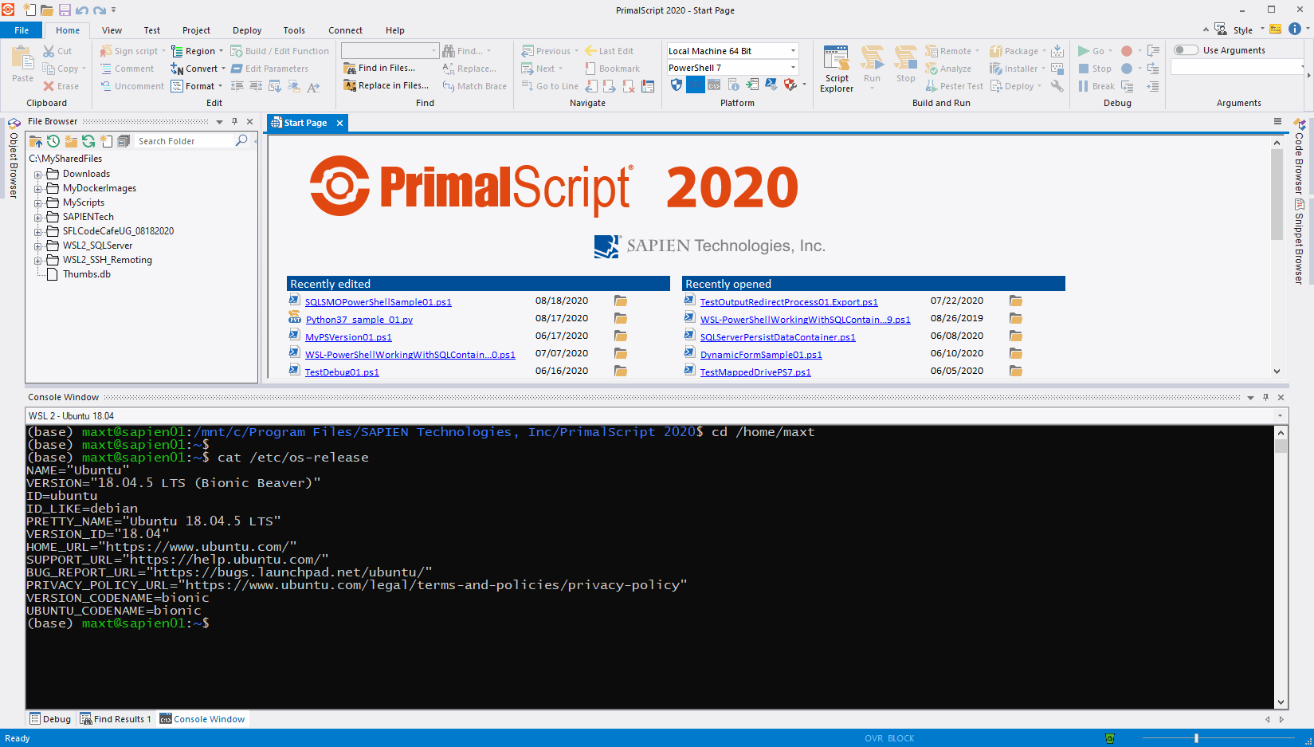
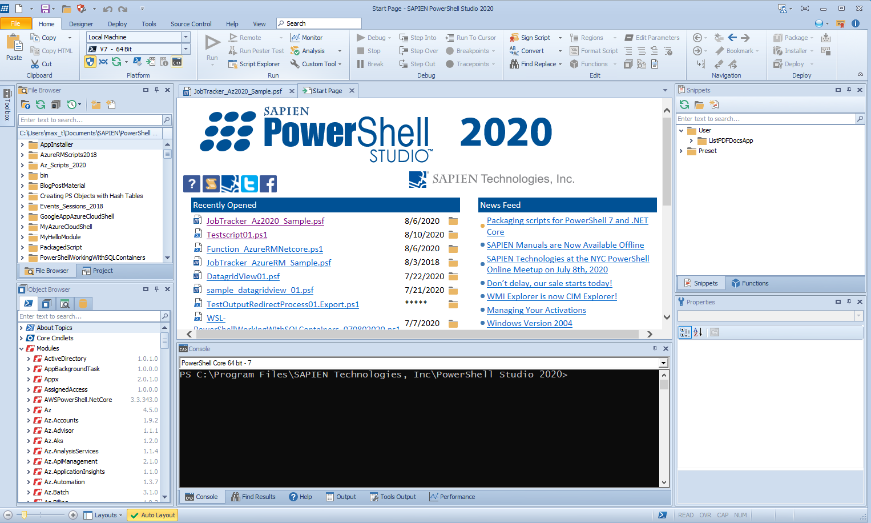
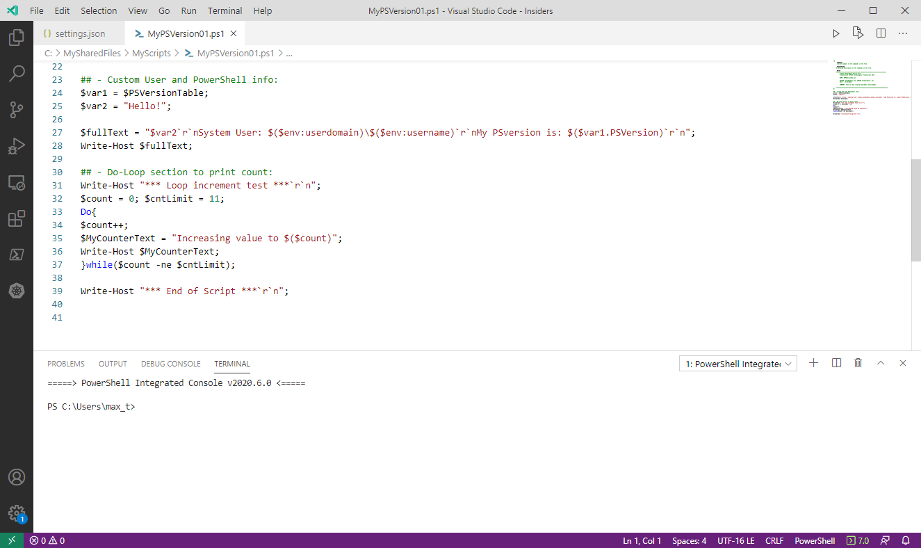
What Is Required?
Windows Terminal “Preview”
Configurable
Commandline support.
Multi-Console in single terminal.
Coding Editors
PrimalScript
PowerShell Studio
VSCode

Slide 24
Notebooks Apps

Slide 25
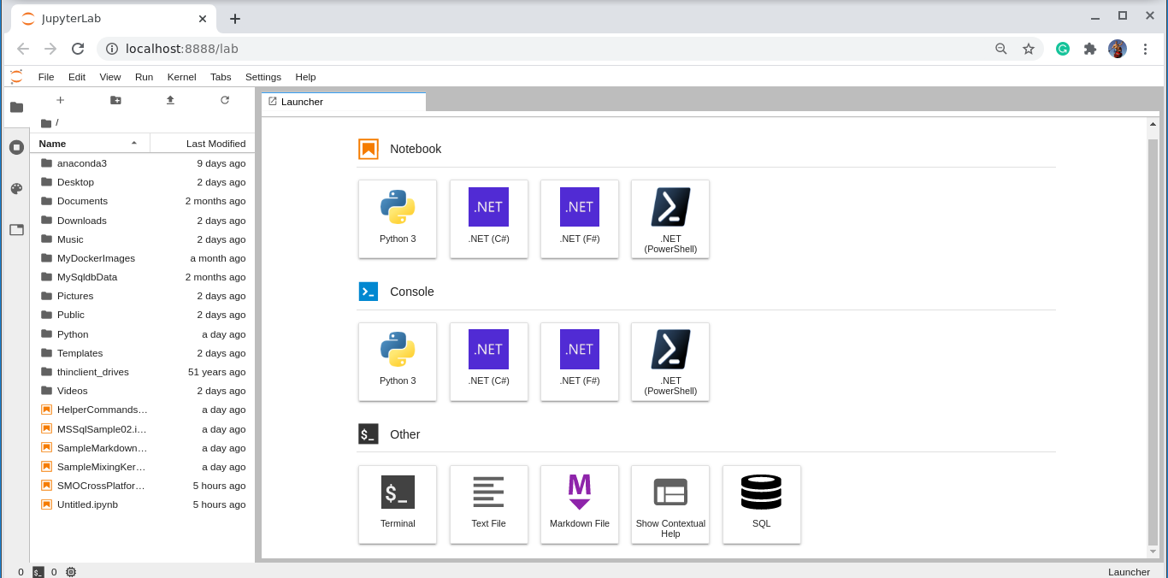
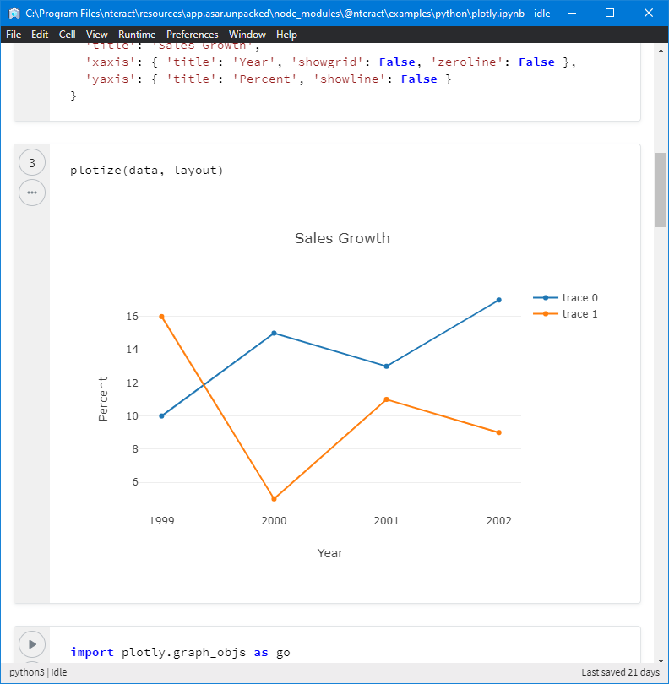
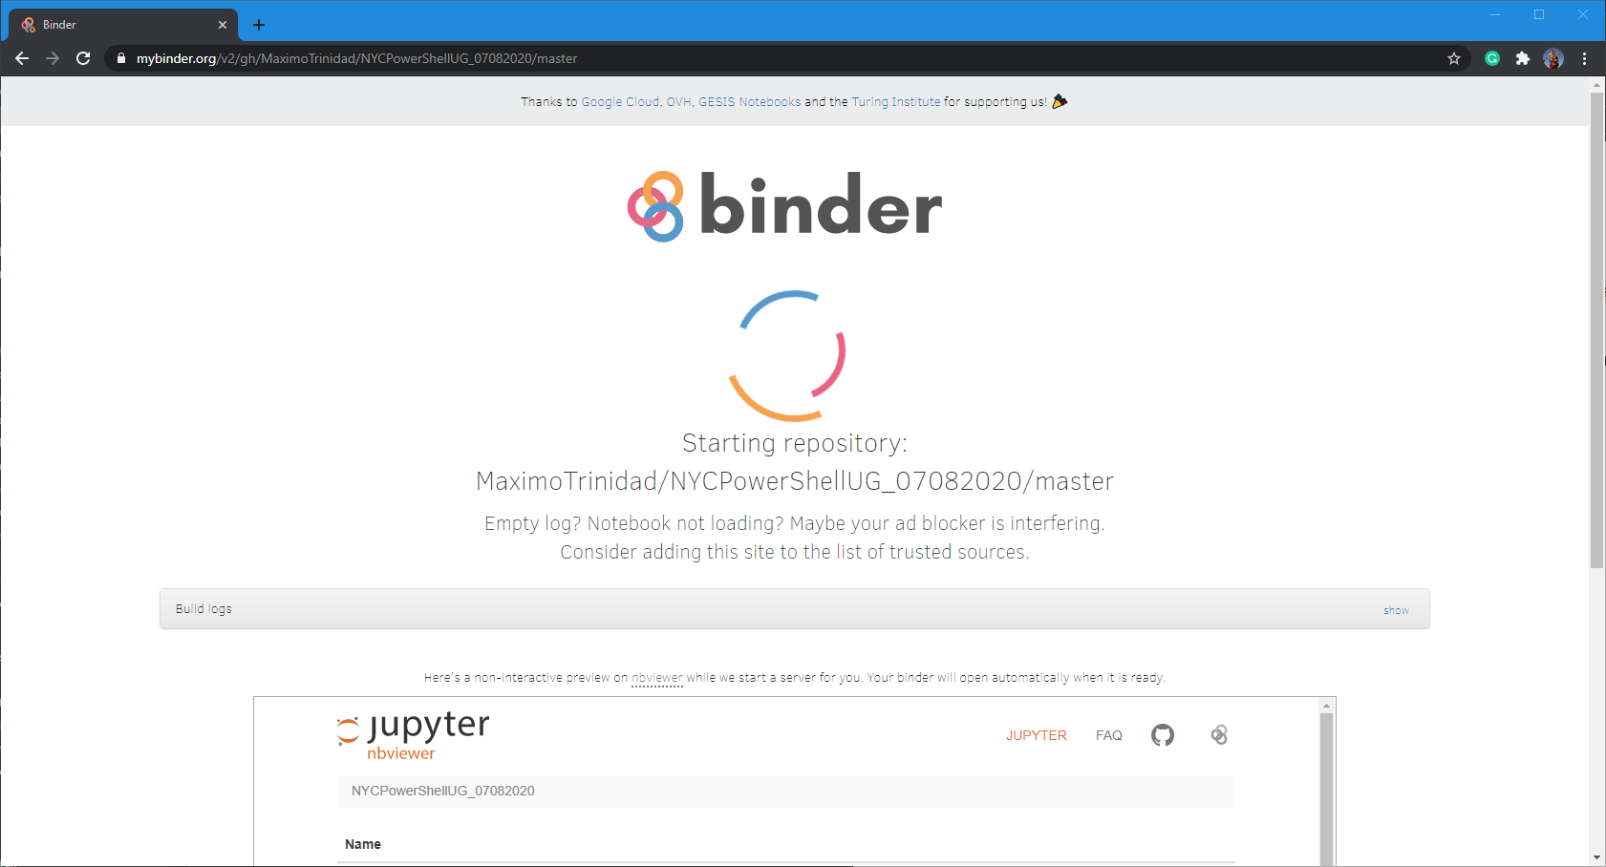
Notebook Apps
What's Available?
Anaconda Jupyter Lab (Browser-based)
Nteract (Application)
Binder (Browser-based)
* No installation required

Slide 26
Demo

Slide 27
.NET Interactive
Two ways to work with Jupyter Notebook:
1. Download and install - Anacoda w/Python 3.7.x (includes Jupyter Notebook) then install .NET Interactive Preview with PowerShell Jupyter Notebook.
https://devblogs.microsoft.com/powershell/public-preview-of-powershell-support-in-jupyter-notebooks/
https://devblogs.microsoft.com/dotnet/net-interactive-is-here-net-notebooks-preview-2/
2. Or, try using “MyBinder” (No installation required) to test-drive .NET Notebook: https://mybinder.org/v2/gh/dotnet/interactive/master?urlpath=lab

Slide 28
.NET Core
Linux Installation Documentation: https://docs.microsoft.com/en-us/dotnet/core/install/linux-ubuntu#1804-
Windows Installation Documentation: https://docs.microsoft.com/en-us/dotnet/core/install/windows?tabs=netcore31

Slide 29
Anaconda – Data Science Platform
Installation documentation: https://www.anaconda.com/products/individual

